Slide 1

21ST CENTURY LITERATURE FROM THE PHILIPPINES AND THE WORLD
(Second Semester, FOURTH GRADING)

Slide 2
MOTIVATIONAL ACTIVITY
GUIDED QUESTION:
WHAT ARE YOUR THOUGHTS ABOUT
THIS IMAGES?

Slide 3

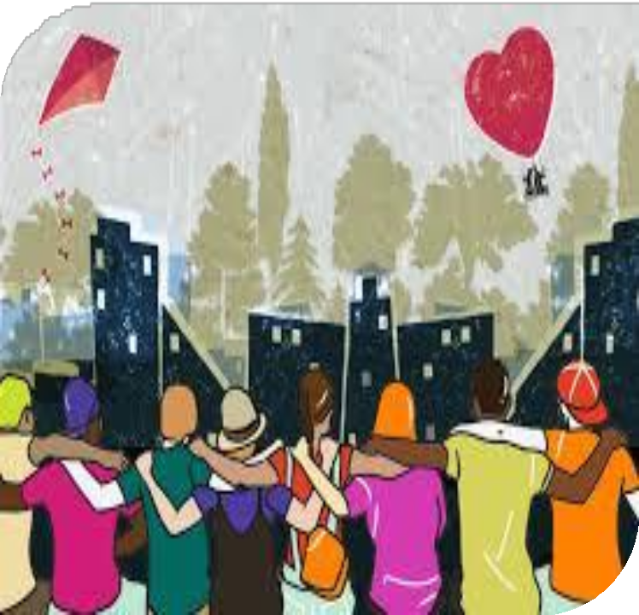

COSMOPOLITANISM

Slide 4
MEMORY OF THE EMPIRE AND/IN THE COSMOPOLITAN PORT CITY
LESSON # 3 (POETRY)
“XVIII” FROM AMSTERDAM: A CYCLE
BY J. NEIL C. GARCIA

Slide 5
WHAT IS COSMOPOLITANISM?
FROM THE WORDS COSMOS (UNIVERSE) AND POLIS (CITY), COSMOPOLITANISM REFERS TO A GLOBAL MIDSET.

Slide 6
IT CHARACTERIZES AN OPENNESS TO THE DIFFERENT CULTURES AND WORLDVIEWS OF PEOPLE.

Slide 7
COSMOPOLITANISM IS THE BELIEF THAT ALL PEOPLE ARE ENTITLED TO EQUAL RESPECT AND CONSIDERATION,

Slide 8
NO MATTER WHAT THEIR CITIZENSHIP, STATUS, OR OTHER AFFILIATIONS HAPPEN TO BE.

Slide 9
MARKERS:
SYNECDOCHE
- USES A PART TO REPRESENT THE WHOLE.
EXAMPLES:
NEW WHEELS - NEW CAR

Slide 10
FACES IN THE CROWD - PEOPLE IN THE CROWD
MOUTHS TO FEED - HUNGRY PEOPLE
KLEENEX - DISPOSABLE TISSUES
BAND-AID - ADHESIVE BANDAGES

Slide 11
- USES SOMETHING ASSOCIATED WITH A THING TO REPRESENT THE THING ITSELF.
METONYMY
EXAMPLES:
DISH - REFERS TO A MEAL

Slide 12
HANDS - REFERS TO HELP
HOLLYWOOD - REFERS TO FILM INDUSTRY
HEAD - REFERS TO PEOPLE
GRAVE - REFERS TO DEATH

Slide 13
ABOUT THE AUTHOR
J. NEIL C. GARCIA IS A FILIPINO POET, ESSAYIST, AND LITERARY CRITIC.

Slide 14
HE GRADUATED MAGNA CUM LAUDE WITH BACHELOR OF ARTS IN JOURNALISM AT THE UNIVERSITY OF SANTO TOMAS IN 1990.

Slide 15
HE LATER TAUGHT COURSES ON CREATIVE WRITING AND LITERATURE AT THE UNIVERSITY OF THE PHILIPPINES DILIMAN IN 2003.

Slide 16
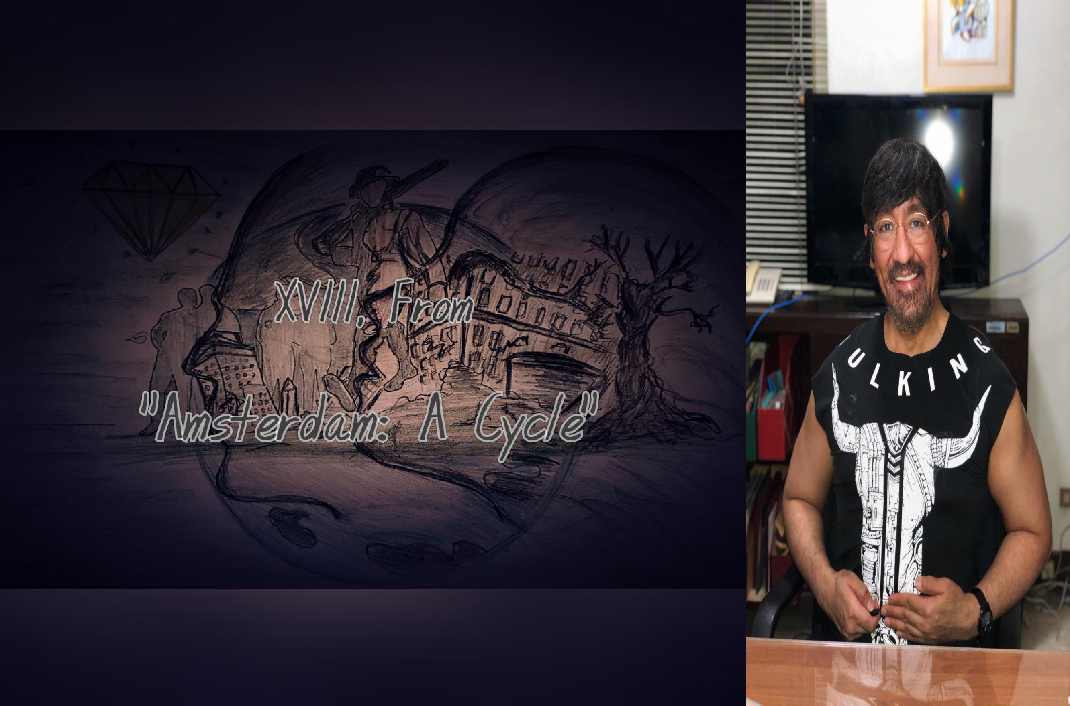

Slide 17
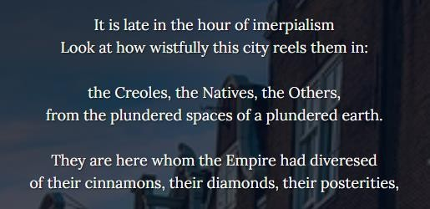

Slide 18
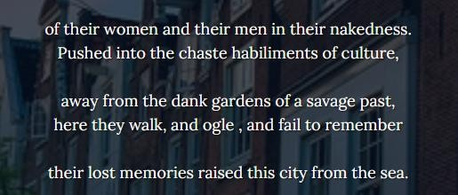

Slide 19
DEFINING UNFAMILIAR
TERMS

Slide 20
IMPERIALISM - A TYPE OF PRACTICE OR POLICY WHERE A COUNTRY BOOSTS ITS POWER BY CONTROLLING OTHER PARTS OF THE WORLD.

Slide 21
CREOLES - PEOPLE WITH AFRICAN, FRENCH, OR SPANISH ANCESTRY.
POSTERITIES - FUTURE GENERATION OR PEOPLE.
HABILIMENTS - CLOTHES.

Slide 22
DANK - UNPLEASANTLY WET AND COLD.
OGLE - LOOK AT SOMETHING OR SOMEONE IN A MANNER THAT SUGGESTS STRONG DESIRE OR INTEREST.

Slide 23
PLUNDER - AN ACT OF STEALING SOMETHING FROM A PLACE USING FORCE.

Slide 24
POEM ANALYSIS

Slide 25
SYNECDOCHE
AMSTERDAM - THE DOMINANT CITY AND CAPITAL CITY OF NETHERLAND.
EMPIRE - THE PEOPLE WITH SUPREME AUTHORITY TO DO WHATEVER THEY WANT.

Slide 26
IMPERIALISM - A PRACTICE BY WHICH COUNTRY EXTENDS ITS POWER TO CONTROL OTHER AREAS OF THE WORLD.

Slide 27
METONYMY
CINNAMONS - THE RESOURCES OF THE PEOPLE.
DIAMONDS - THE WEALTH OF THE CITY THAT WAS BEING CONTROLLED.

Slide 28
SEA - A LOW STATE CONDITION.

Slide 29
POEM INTERPRETATION

Slide 30
IT IS LATE IN THE HOUR OF IMPERIALISM…
THIS LINE TELLS US FIGURATIVELY THAT IMPERIALISM IS HAPPENING IN THE COUNTRY, HOWEVER, SOONER OR LATER IT WILL SUBSIDE AND EVENTUALLY COME TO AN END.

Slide 31
BUT BEFORE IMPERIALISM EVEN STARTED, AMSTERDAM USED TO BE A HOTSPOT FOR TRADING GOODS, CULTURES, AND SERVICES.

Slide 32
WHAT MAKES IT SUCH IS BECAUSE THE AREA IS JUST BY THE SEA WHICH MAKES IT AN ACCESSIBLE PLACE FOR TRADING AND OTHERS.

Slide 33
HOWEVER, DUE TO FREQUENT TRADING, OTHER COUNTRIES FOUND INTEREST WHICH INDEED LED TO COLONIZATION.

Slide 34
THE FIRST FOUR STANZAS OF THE POEM DESCRIBE HOW MISERABLE THE PEOPLE WERE IN AMSTERDAM BECAUSE OF UNEQUAL TREATMENT AND DISCRIMINATION THAT IS HAPPENING.

Slide 35
FOUND IN THE 2ND STANZA, THE CREOLES REPRESENTED THE BLACK AND EUROPEAN PEOPLE, THE NATIVES REPRESENTED THE LOCAL CITIZENS OF AMSTERDAM,

Slide 36
WHILE THE OTHERS REPRESENTED PEOPLE OF DIFFERENT NATIONALITIES WHO LIVED IN AMSTERDAM.

Slide 37
CRUELTY AND DISCRIMINATION WERE VERY EVIDENT IN THE POEM FOR J. NEIL GARCIA EXPERIENCED IT HIMSELF WHERE-

Slide 38
THE HIGHER-CLASS PEOPLE WOULD CONTROL THE CREOLES, THE NATIVES, AND OTHER NATIONALITIES LIVING IN AMSTERDAM.

Slide 39
BUT IT ENDS UP IN CITIZENS’ REAWAKENING, THEN REVOLUTION. WITH THIS, CHAOS TOOK PLACE, BUT LIKE MOST THINGS, IT ALWAYS GETS TO AN END.

Slide 40
BY THE TIME ALL THE JEOPARDY IS OVER, THERE IS SOMEWHAT OF A SENSE OF OPENNESS AND UNITY CREATED BETWEEN THE DISTINCT PEOPLE OF THAT AREA WHICH LED TO A DIVERSITY OF CULTURES,

Slide 41
NATIONALITIES AND IDEAS COEXIST IN THE SAME AREA IN THE CONCEPT OF COSMOPOLITANISM.

Slide 42
THROUGH TIME, AS SCARS SLOWLY FADE, PEOPLE MOVE FORWARD, COEXISTING WITH OTHERS,

Slide 43
EMBRACING DIFFERENT YET FRESHER PERSPECTIVES, AND WALLOWING IN THE BLISS OF FREEDOM.

Slide 44
HOWEVER, PEOPLE END UP NOT REMEMBERING THE PAST BECAUSE IT’S AS IF EVEN THE MOST STUBBORN SCARS HAVE HEALED AND NOTHING HAPPENED AT ALL.

Slide 45
THIS MENTALITY, ONE WAY OR ANOTHER, CAN HINDER SUCCESS IN THE FUTURE BECAUSE FORGETTING THE VALUE OF THE PAST AND ITS MISTAKES CAN USUALLY LEAD TO HISTORY REPEATING ITSELF.

Slide 46
